Slide 1
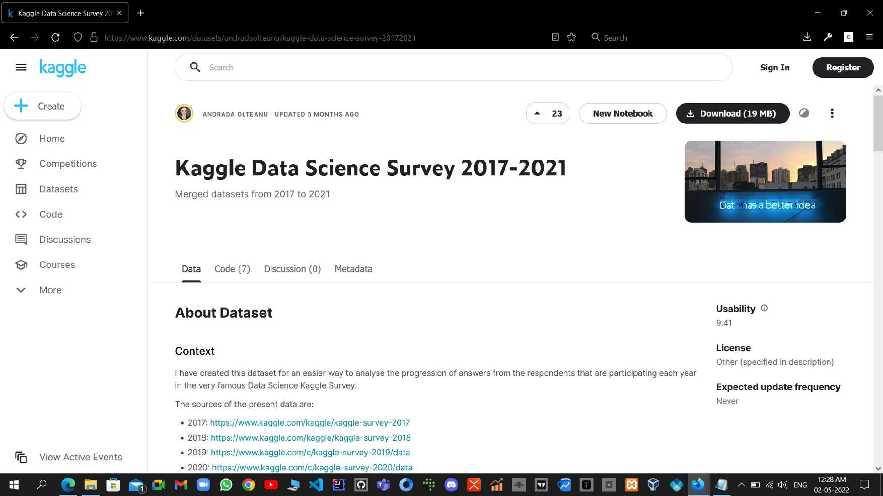

Slide 2
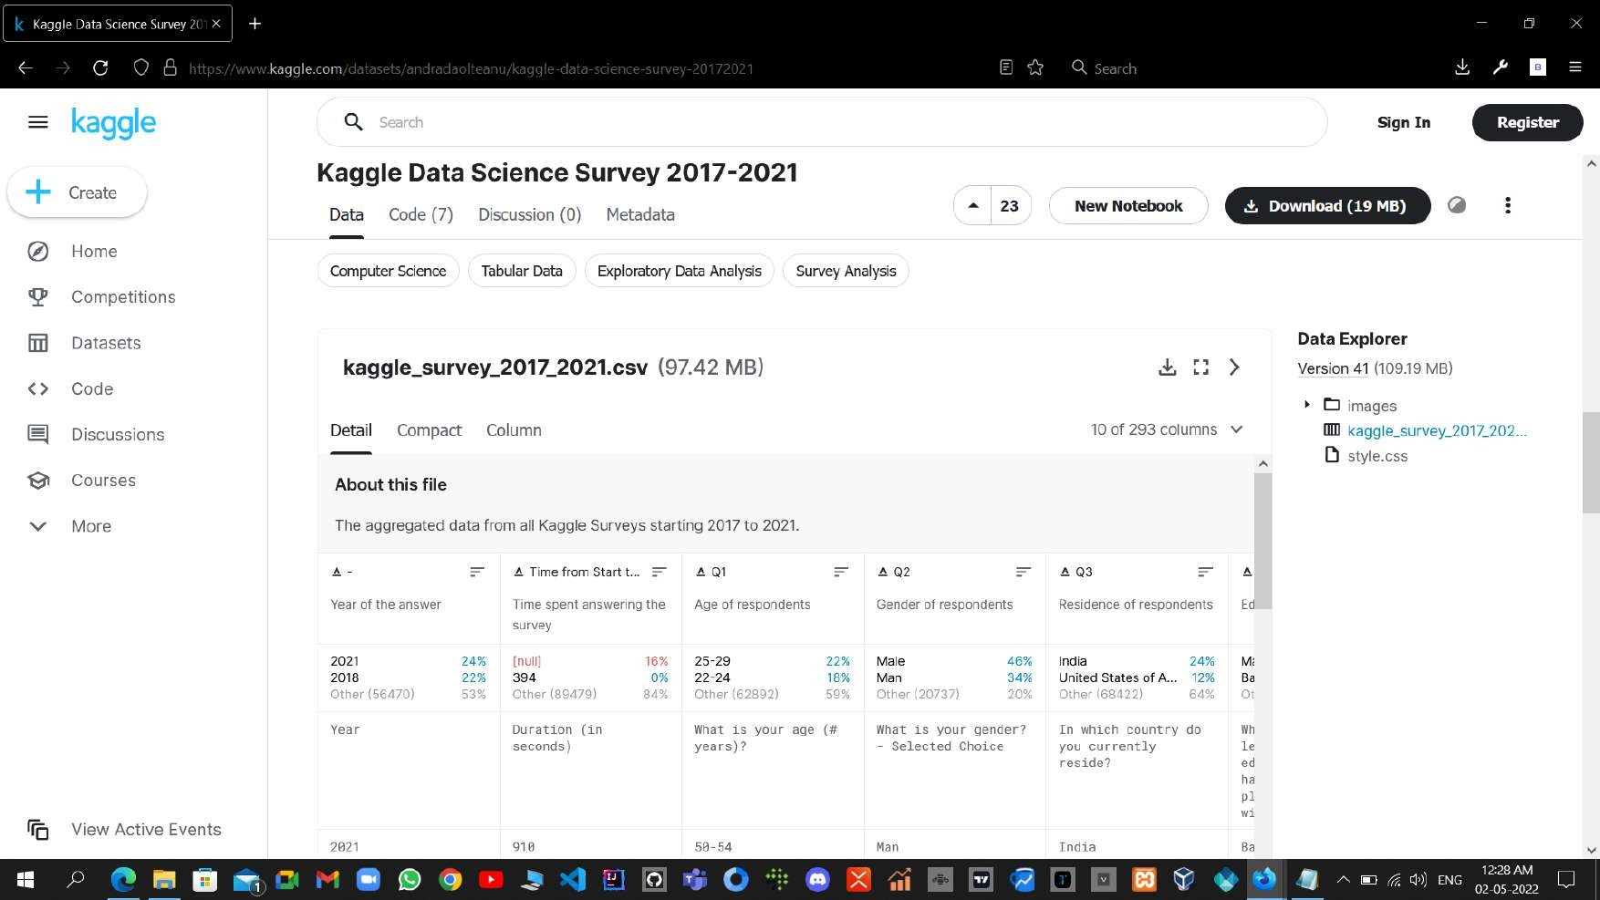

Slide 3
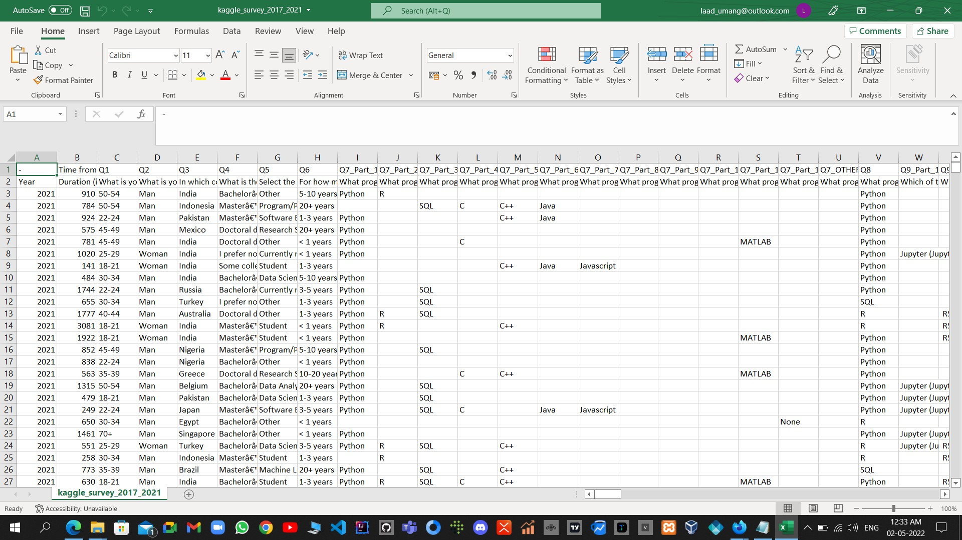

Slide 4
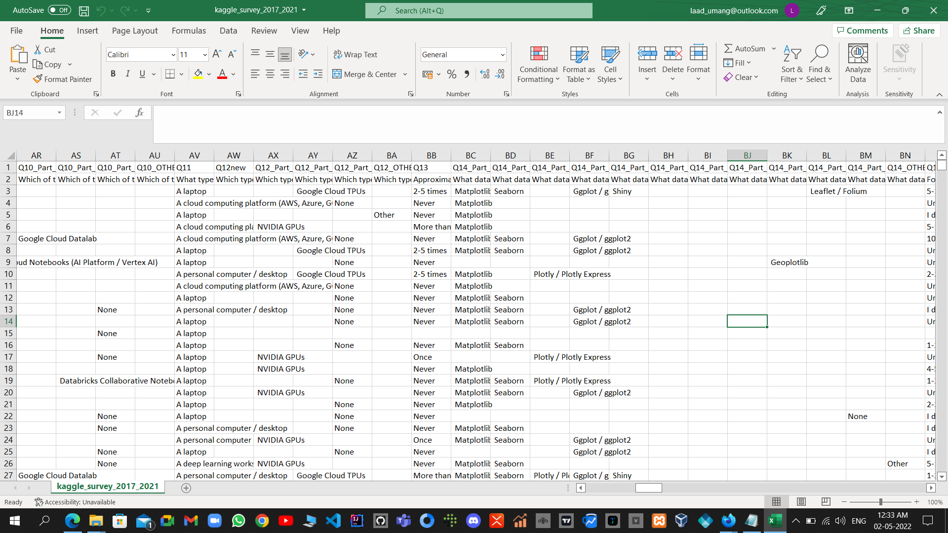

Slide 5
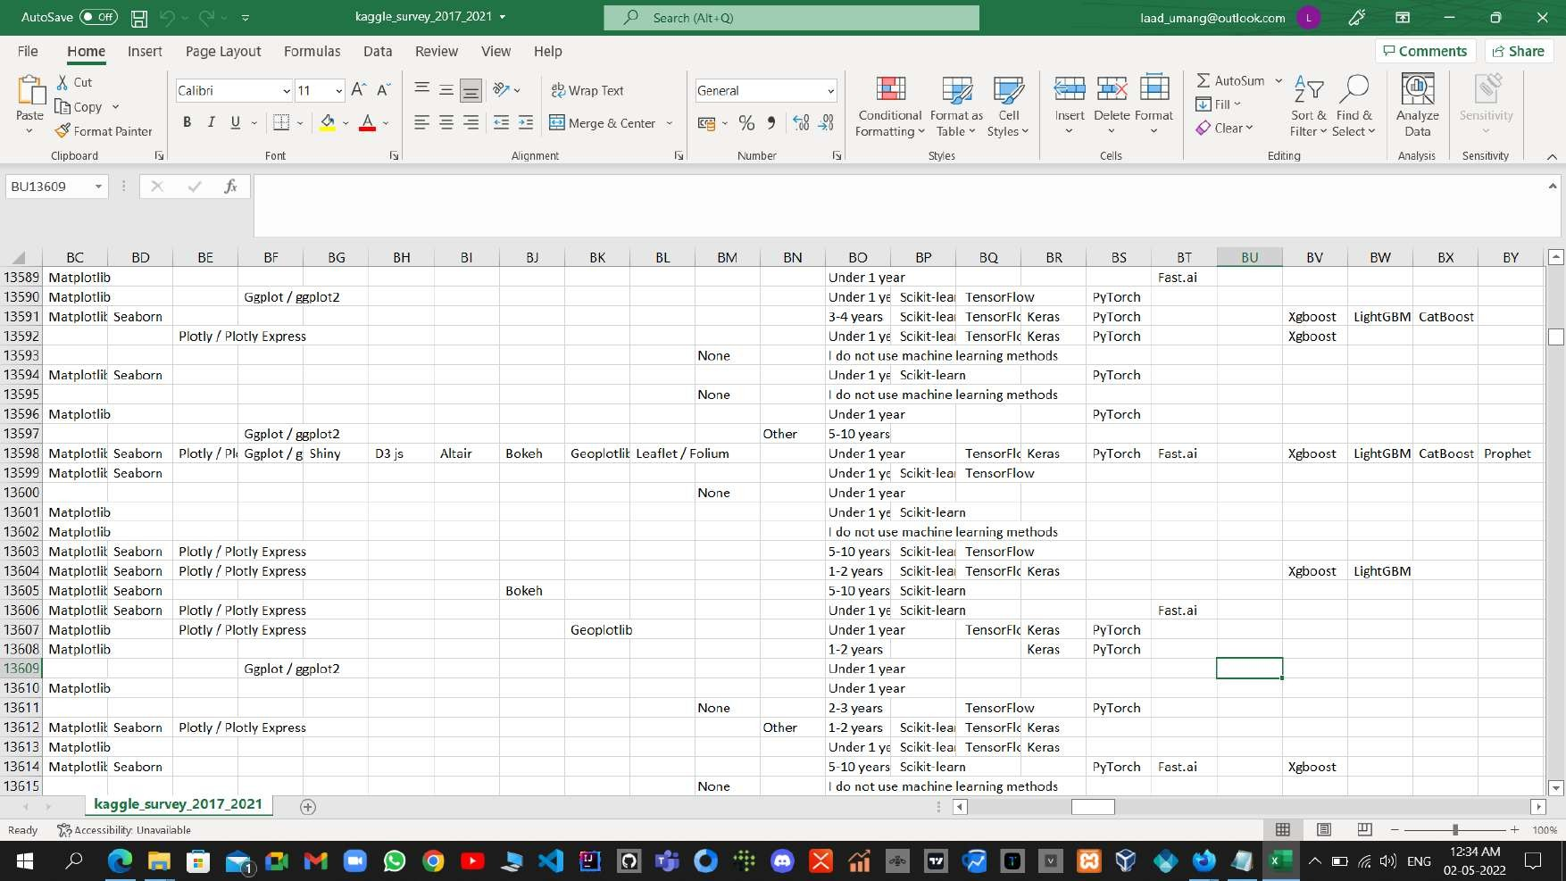

Slide 6
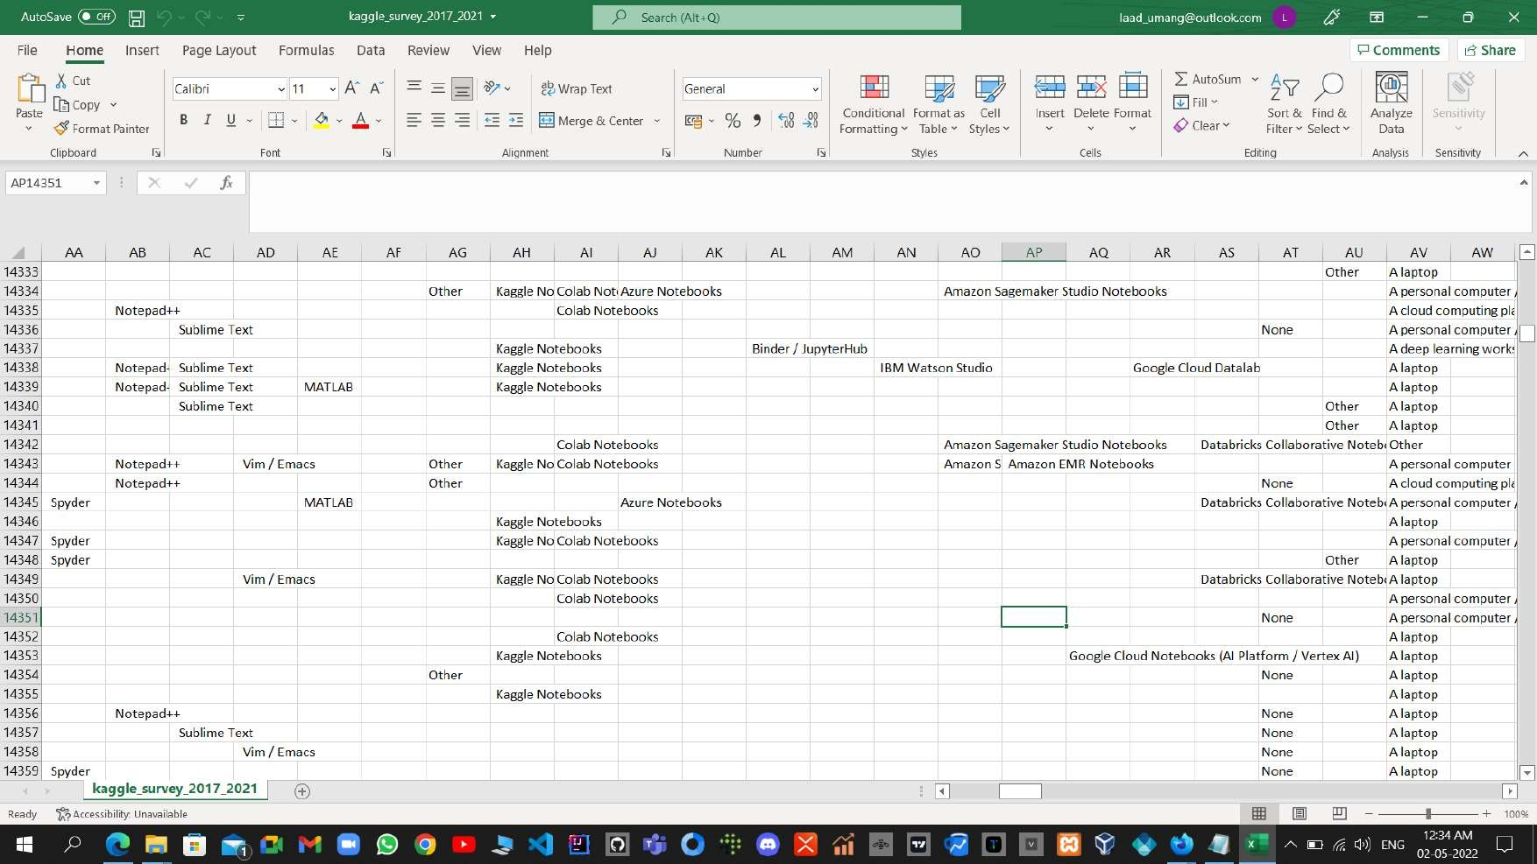

Slide 7
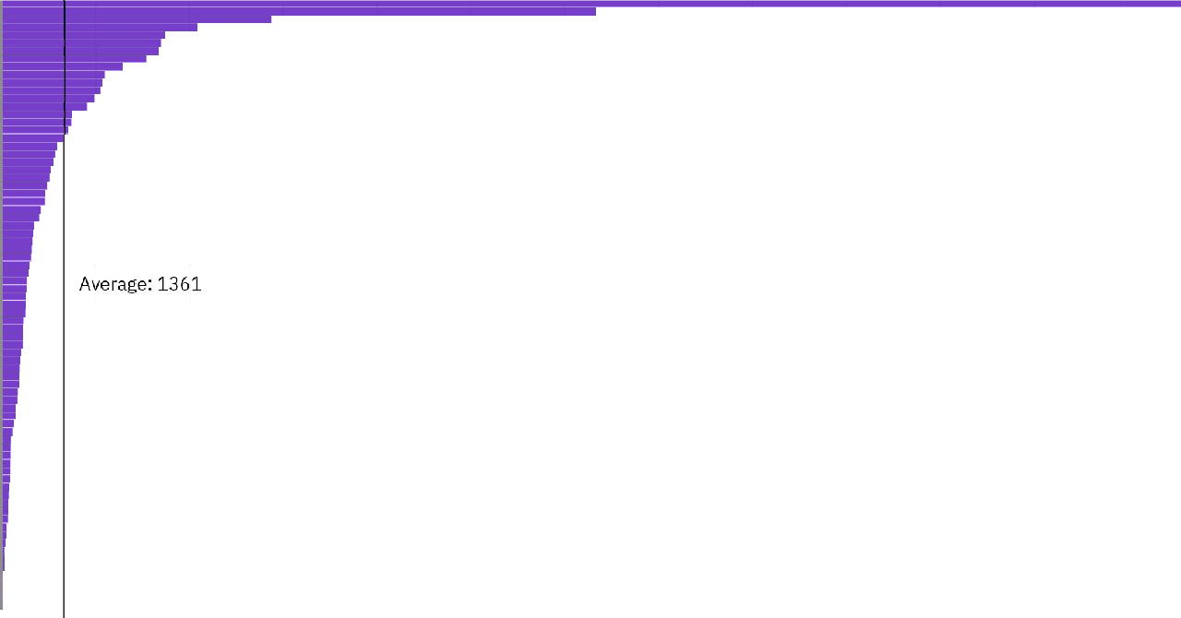
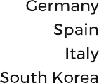
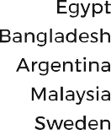

Kaggle Data Science Survey 2017-2021 - Umang Laad
https://eu1.ca.analytics.ibm.com/bi/?perspective=dashboard&id=iFE019C17216F4805805A7...

Slide 8





Kaggle Data Science Survey 2017-2021 - Umang Laad
https://eu1.ca.analytics.ibm.com/bi/?perspective=dashboard&id=iFE019C17216F4805805A7...

Slide 9

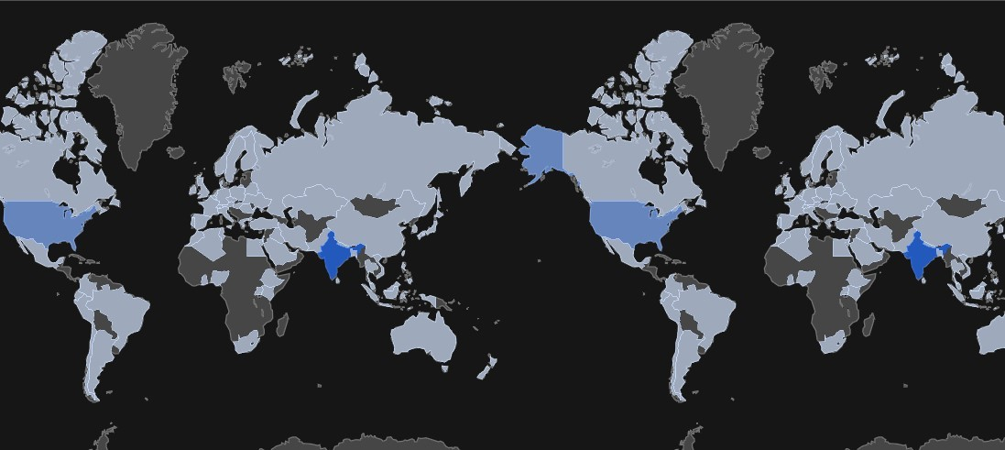

Kaggle Data Science Survey 2017-2021 - Umang Laad
https://eu1.ca.analytics.ibm.com/bi/?perspective=dashboard&id=iFE019C17216F4805805A7...

Slide 10
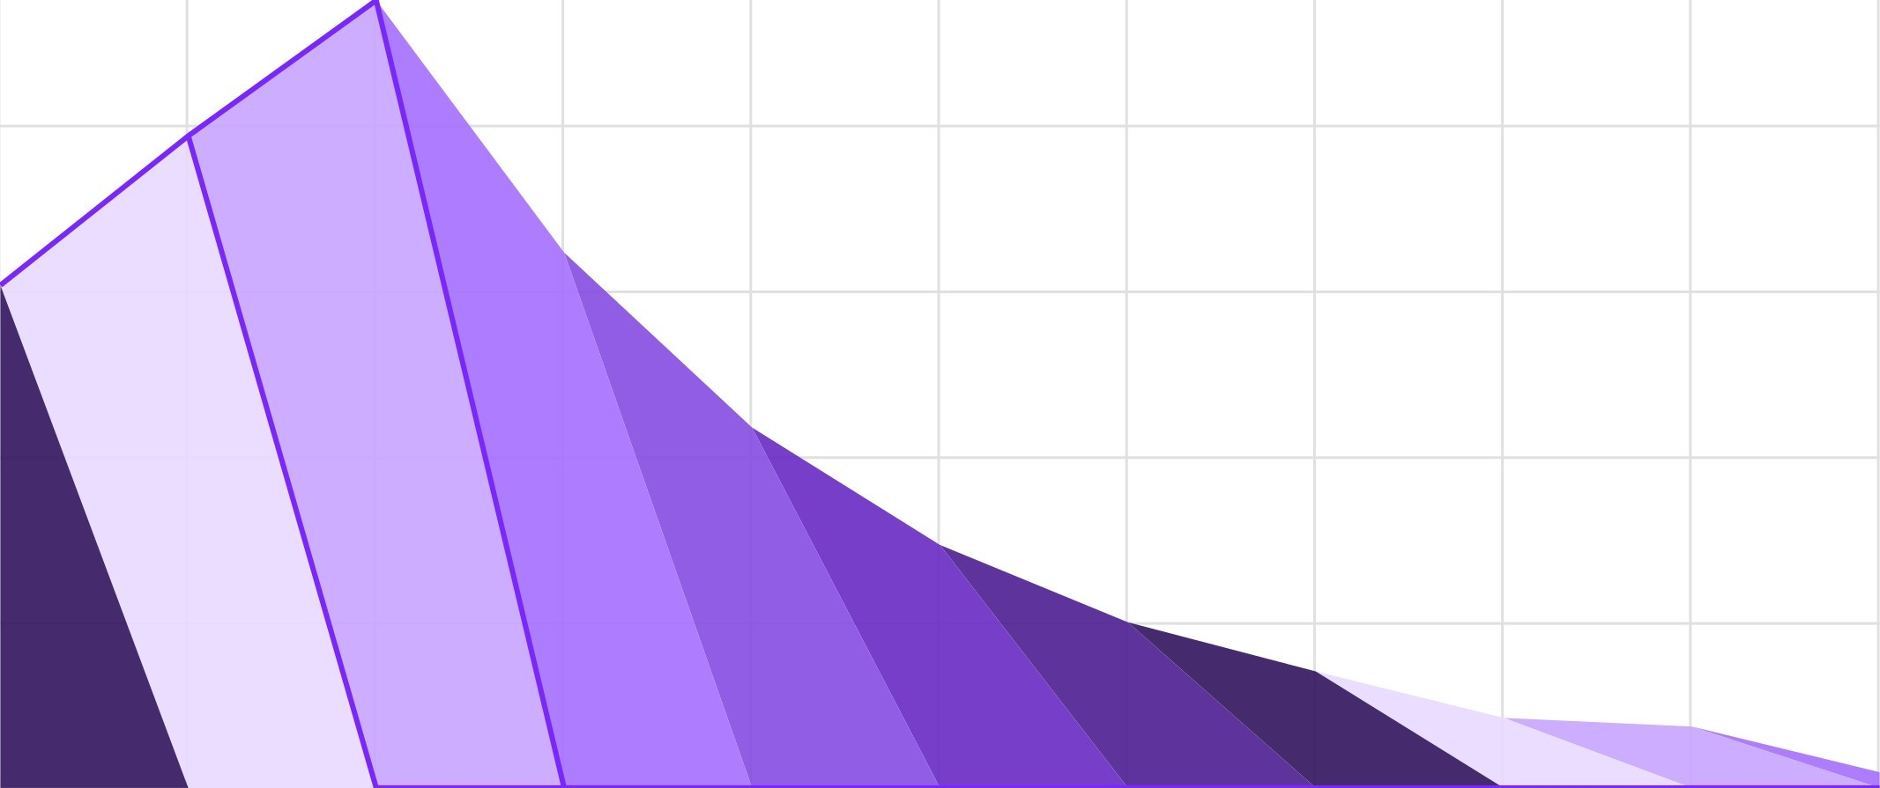
Kaggle Data Science Survey 2017-2021 - Umang Laad
https://eu1.ca.analytics.ibm.com/bi/?perspective=dashboard&id=iFE019C17216F4805805A7...

Slide 11



Kaggle Data Science Survey 2017-2021 - Umang Laad
https://eu1.ca.analytics.ibm.com/bi/?perspective=dashboard&id=iFE019C17216F4805805A7...

Slide 12












Kaggle Data Science Survey 2017-2021 - Umang Laad
https://eu1.ca.analytics.ibm.com/bi/?perspective=dashboard&id=iFE019C17216F4805805A7...

Slide 13












Kaggle Data Science Survey 2017-2021 - Umang Laad
https://eu1.ca.analytics.ibm.com/bi/?perspective=dashboard&id=iFE019C17216F4805805A7...

Slide 14

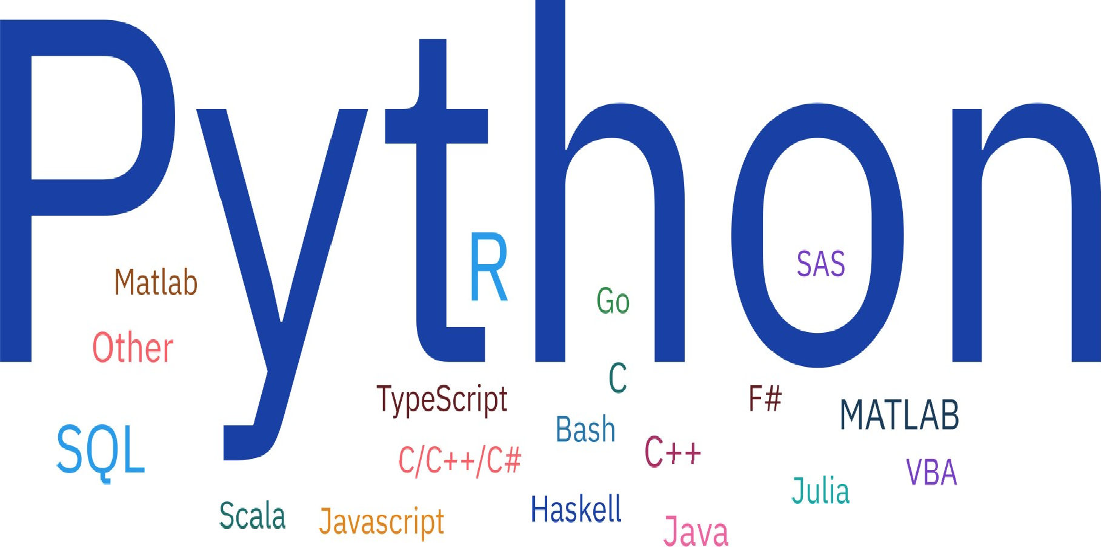


Kaggle Data Science Survey 2017-2021 - Umang Laad
https://eu1.ca.analytics.ibm.com/bi/?perspective=dashboard&id=iFE019C17216F4805805A7...

Slide 15

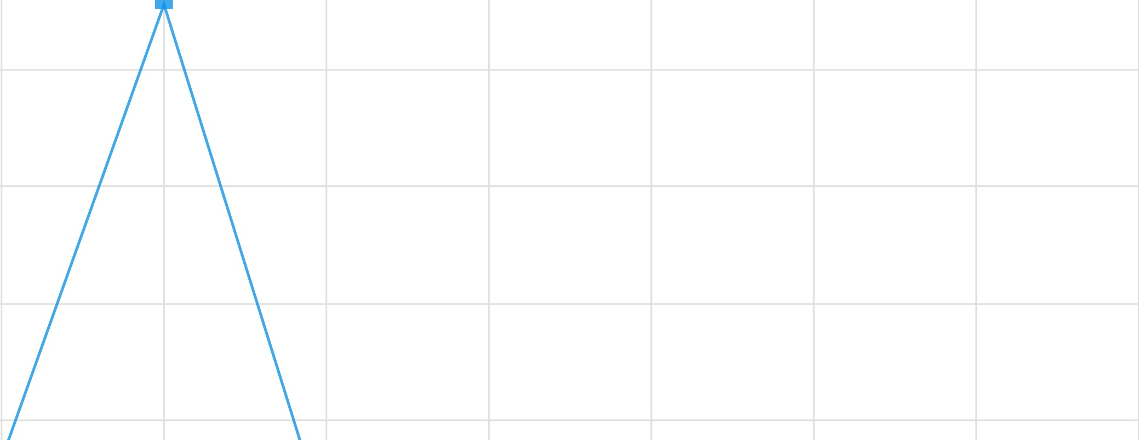
Kaggle Data Science Survey 2017-2021 - Umang Laad
https://eu1.ca.analytics.ibm.com/bi/?perspective=dashboard&id=iFE019C17216F4805805A7...

Slide 16

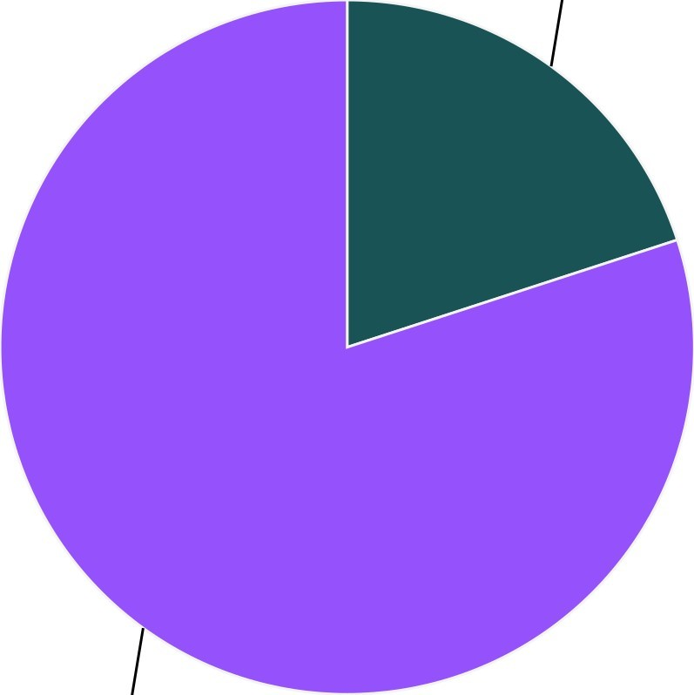
Kaggle Data Science Survey 2017-2021 - Umang Laad
https://eu1.ca.analytics.ibm.com/bi/?perspective=dashboard&id=iFE019C17216F4805805A7...
10 of 15

Slide 17






Kaggle Data Science Survey 2017-2021 - Umang Laad
https://eu1.ca.analytics.ibm.com/bi/?perspective=dashboard&id=iFE019C17216F4805805A7...
11 of 15

Slide 18







Kaggle Data Science Survey 2017-2021 - Umang Laad
https://eu1.ca.analytics.ibm.com/bi/?perspective=dashboard&id=iFE019C17216F4805805A7...
12 of 15

Slide 19


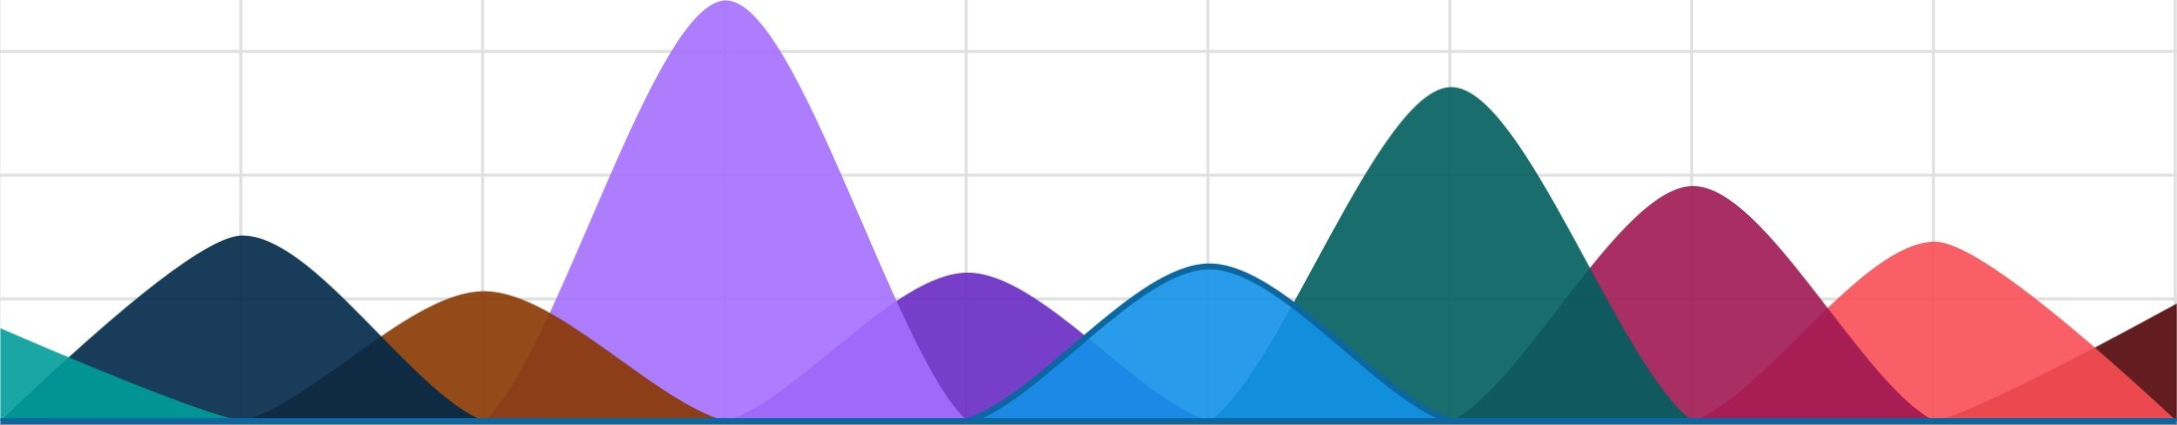
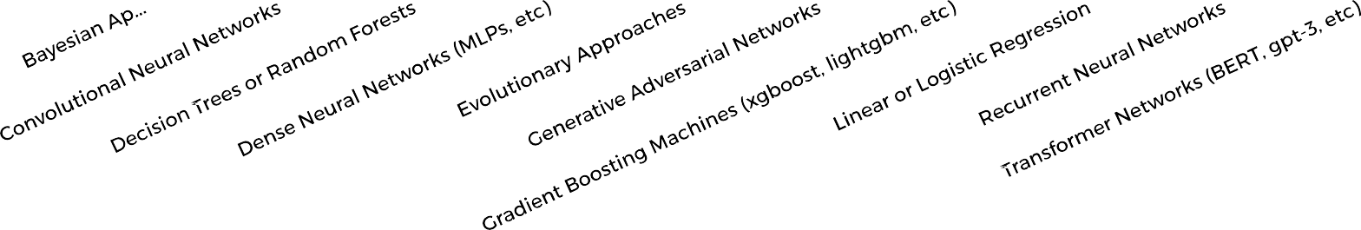
Kaggle Data Science Survey 2017-2021 - Umang Laad
https://eu1.ca.analytics.ibm.com/bi/?perspective=dashboard&id=iFE019C17216F4805805A7...
13 of 15

Slide 20






Kaggle Data Science Survey 2017-2021 - Umang Laad
https://eu1.ca.analytics.ibm.com/bi/?perspective=dashboard&id=iFE019C17216F4805805A7...
14 of 15

Slide 21







Kaggle Data Science Survey 2017-2021 - Umang Laad
https://eu1.ca.analytics.ibm.com/bi/?perspective=dashboard&id=iFE019C17216F4805805A7...
15 of 15

